Slide 1

JSS MAHAVIDYAPEETHA JSS ACADEMY OF TECHNICAL EDUCATION BENGALURU DEPARTMENT OF COMPUTER SCIENCE & ENGINEERING PROJECT TITLE: DRIVER DISTRACTION & DROWSINESS DETECTION SYSTEM
PROJECT GUIDE: Dr. Prabhudev Jagadeesh
TEAM MEMBERS:
AKANSHA JAIN 1JS16CS005
KARTIK NESARI 1JS15CS047
PratIK SHANKAR 1JS16CS072
PRAWALIKA TEWARI 1JS16CS073

Slide 2
OBJECTIVES
To develop a system using machine learning that can prevent a driver from getting distracted or drowsy while driving.
To overcome the problem related to accidents leads to a need to design a system that keeps the driver focused on the road.

Slide 3
TENSORFLOW
TensorFlow is an open-source library for Deep Learning and Machine learning. It is called TensorFlow because it takes input as a multi-dimensional array, also known as tensors.
It is mainly used for Classification, Perception, Understanding, Discovering, Prediction and Creation.
Advantages: Parallelism, Distributed execution, Compilation, Portability
Runs on desktop and mobile devices such as Linux, macOS, iOS, Android, Raspberry pi and Windows .

Slide 4
TensorFlow Architecture
TensorFlow architecture includes :
1) Data Collection and processing
2) Model Development
3) Model Training and estimating
Here we are implementing Convolutional Neural Networks (CNN) with TensorFlow
CNN: Convolutional neural networks (CNN) are the architecture behind computer vision applications.
It usually refers to a deep convolutional network for object recognition developed and trained by Oxford's renowned Visual Geometry Group (VGG), which achieved very good performance on the ImageNet dataset.

Slide 5
METHODOLOGY
And progress report

Slide 6
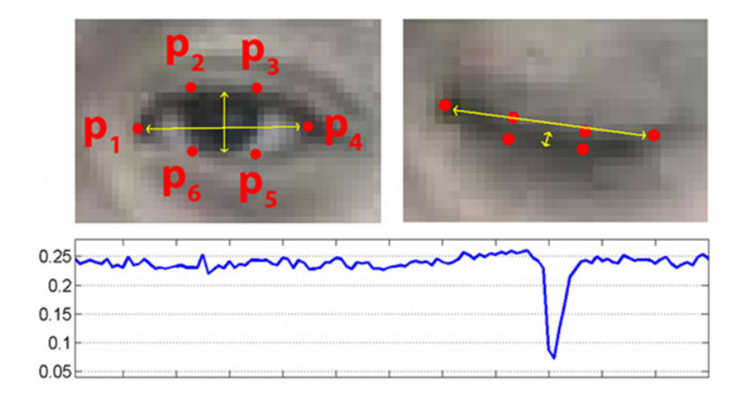
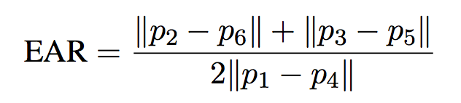
Eye Detection:
Eye Landmark Detection:
Each eye is represented by 6 (x, y)-coordinates, starting at the left-corner of the eye (as if you were looking at the person), and then working clockwise around the remainder of the region:
It generates the Eye Aspect Ratio using the following formula:

Slide 7

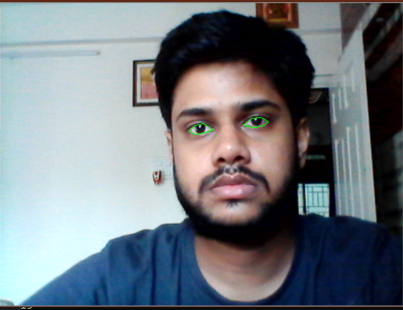

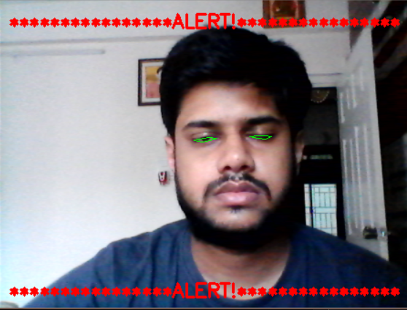



Our software is successfully detecting the eye based on the Eye aspect ratio and is able to detect when to alert the driver.

Slide 8
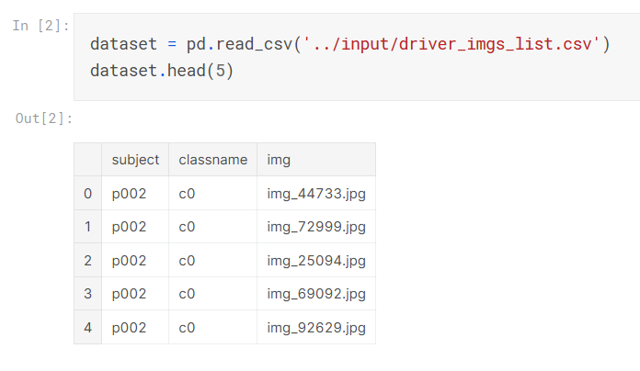
Face Detection:
Face detection is necessary to find whether the driver is distracted or not .If the driver moves his face in any direction other than towards the screen, In that case, driver is found to be distracted.

Slide 9
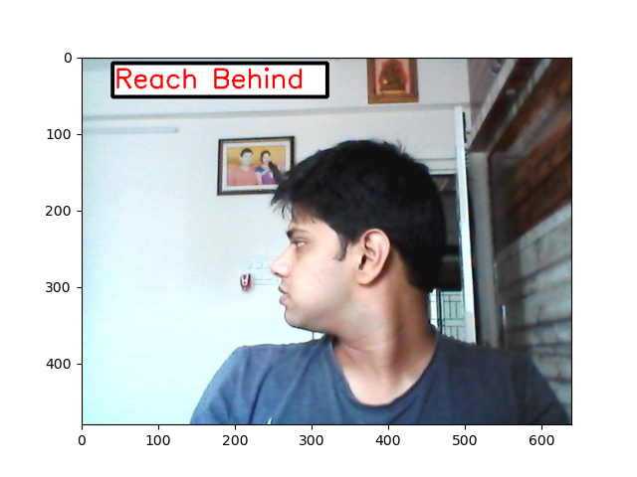
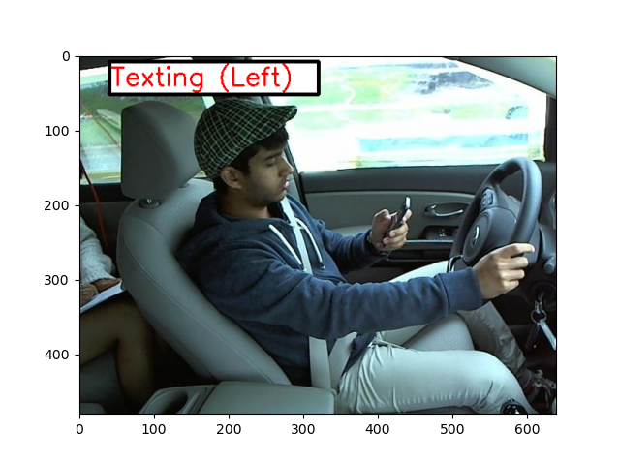
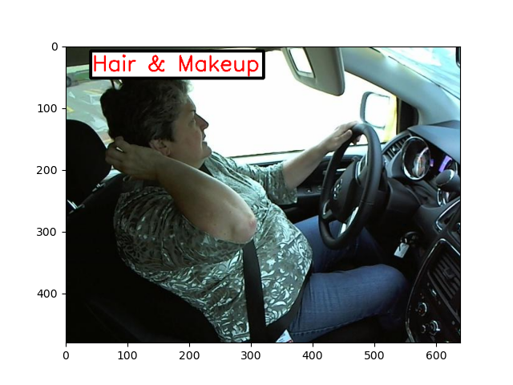
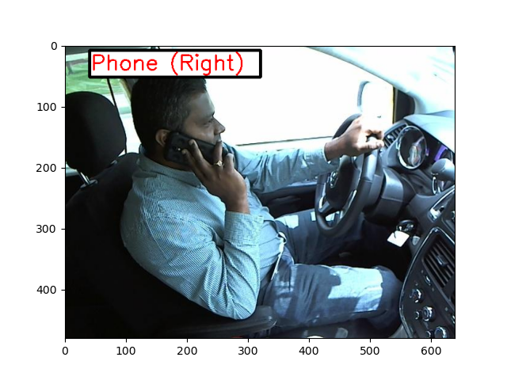
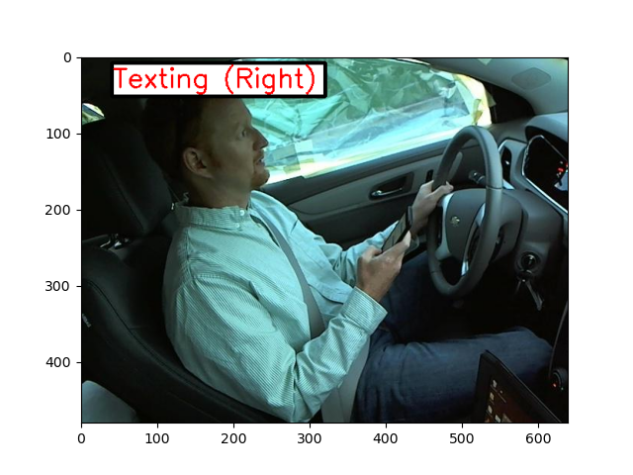
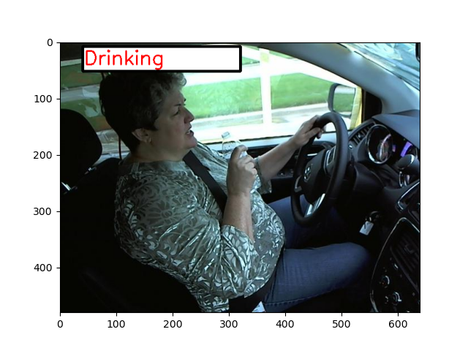

Slide 10
Chatting and Alerting system
Once the system detects that the driver is either drowsy or distracted, Aim is for the system to generate an alarm and enable chatting feature which constantly chats with the driver, asks driver questions and also plays music.
Now We have developed a simple Chatbot that will be able to have a conversation with the driver.
In order to actually play our WAV/MP3 alarm, we need the playsound library, a pure Python, cross-platform implementation for playing simple sounds.

Slide 11
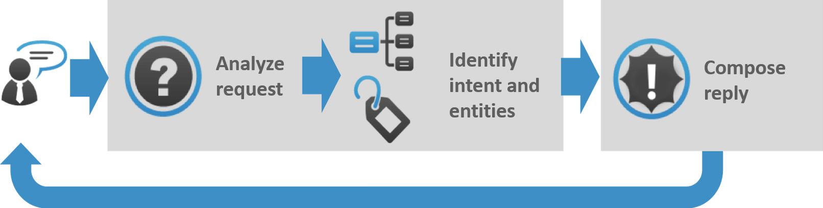
What is a Chat Bot?
A chatbot is an artificial intelligence (AI) software that can simulate a conversation (or a chat) with a user in natural language through messaging applications, websites, mobile apps or through the telephone.
A chatbot is often described as one of the most advanced and promising expressions of interaction between humans and machines.

Slide 12
Natural Language Processing & Natural Language Toolkit
NLP
Natural Language Processing is a blanket term used to describe a machine’s ability to ingest what is said to it, break it down, comprehend its meaning, determine appropriate action, and respond back in language the user will understand.
The input and output of an NLP system can be −
Speech
Written Text
NLTK
Natural Language Toolkit in an open source NLP library, written in Python.
It contains text processing libraries.

Slide 13
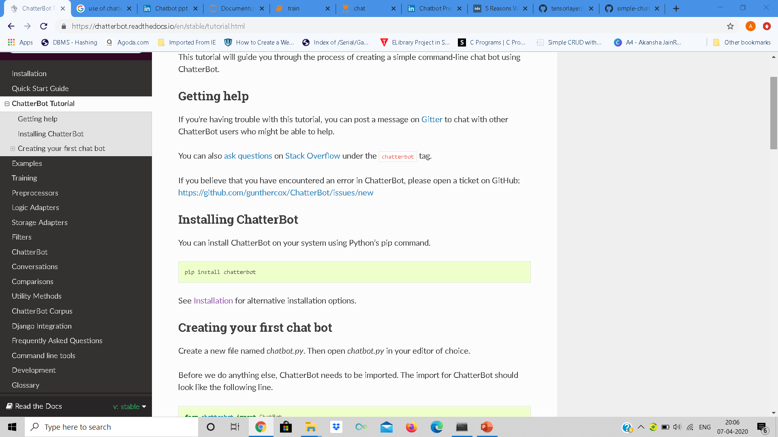
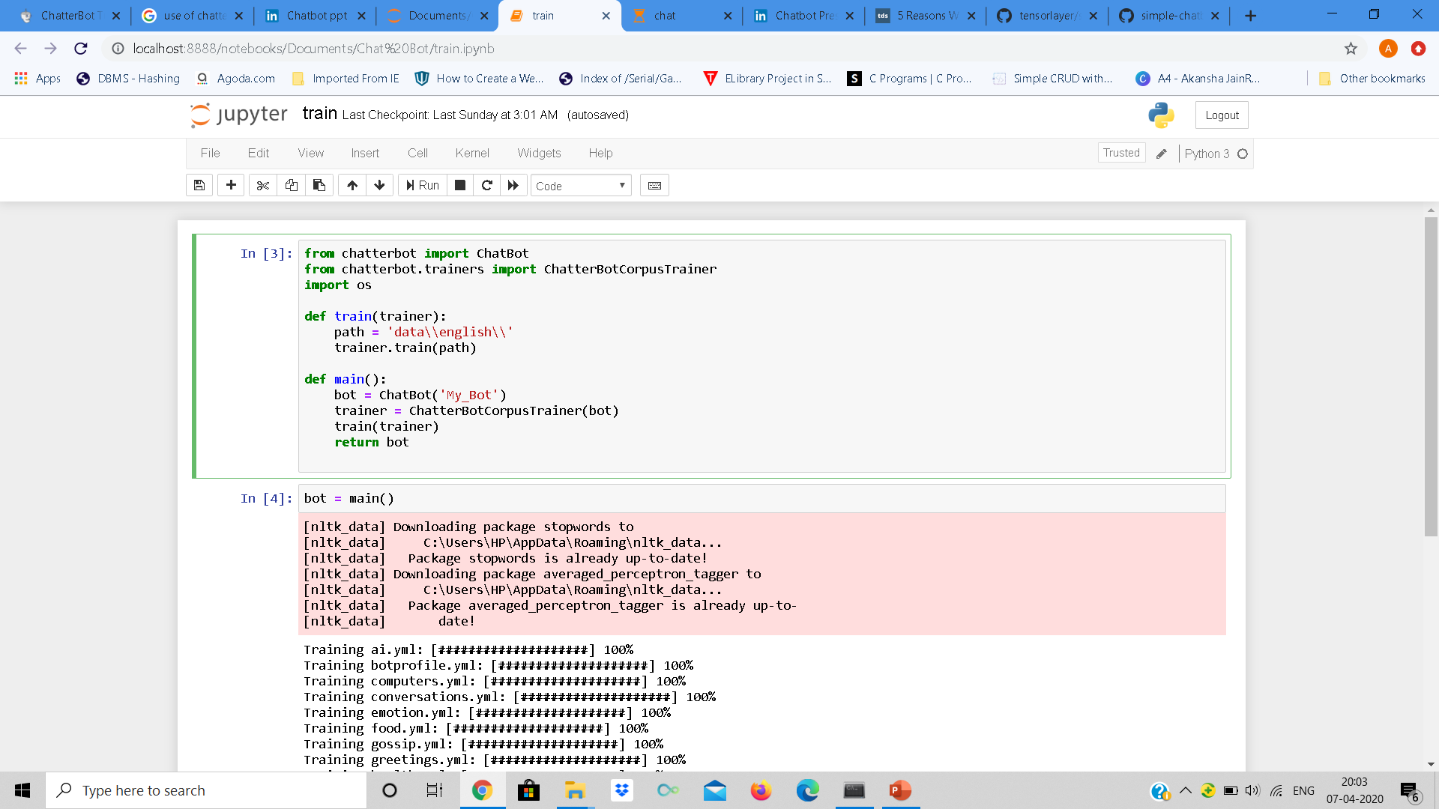
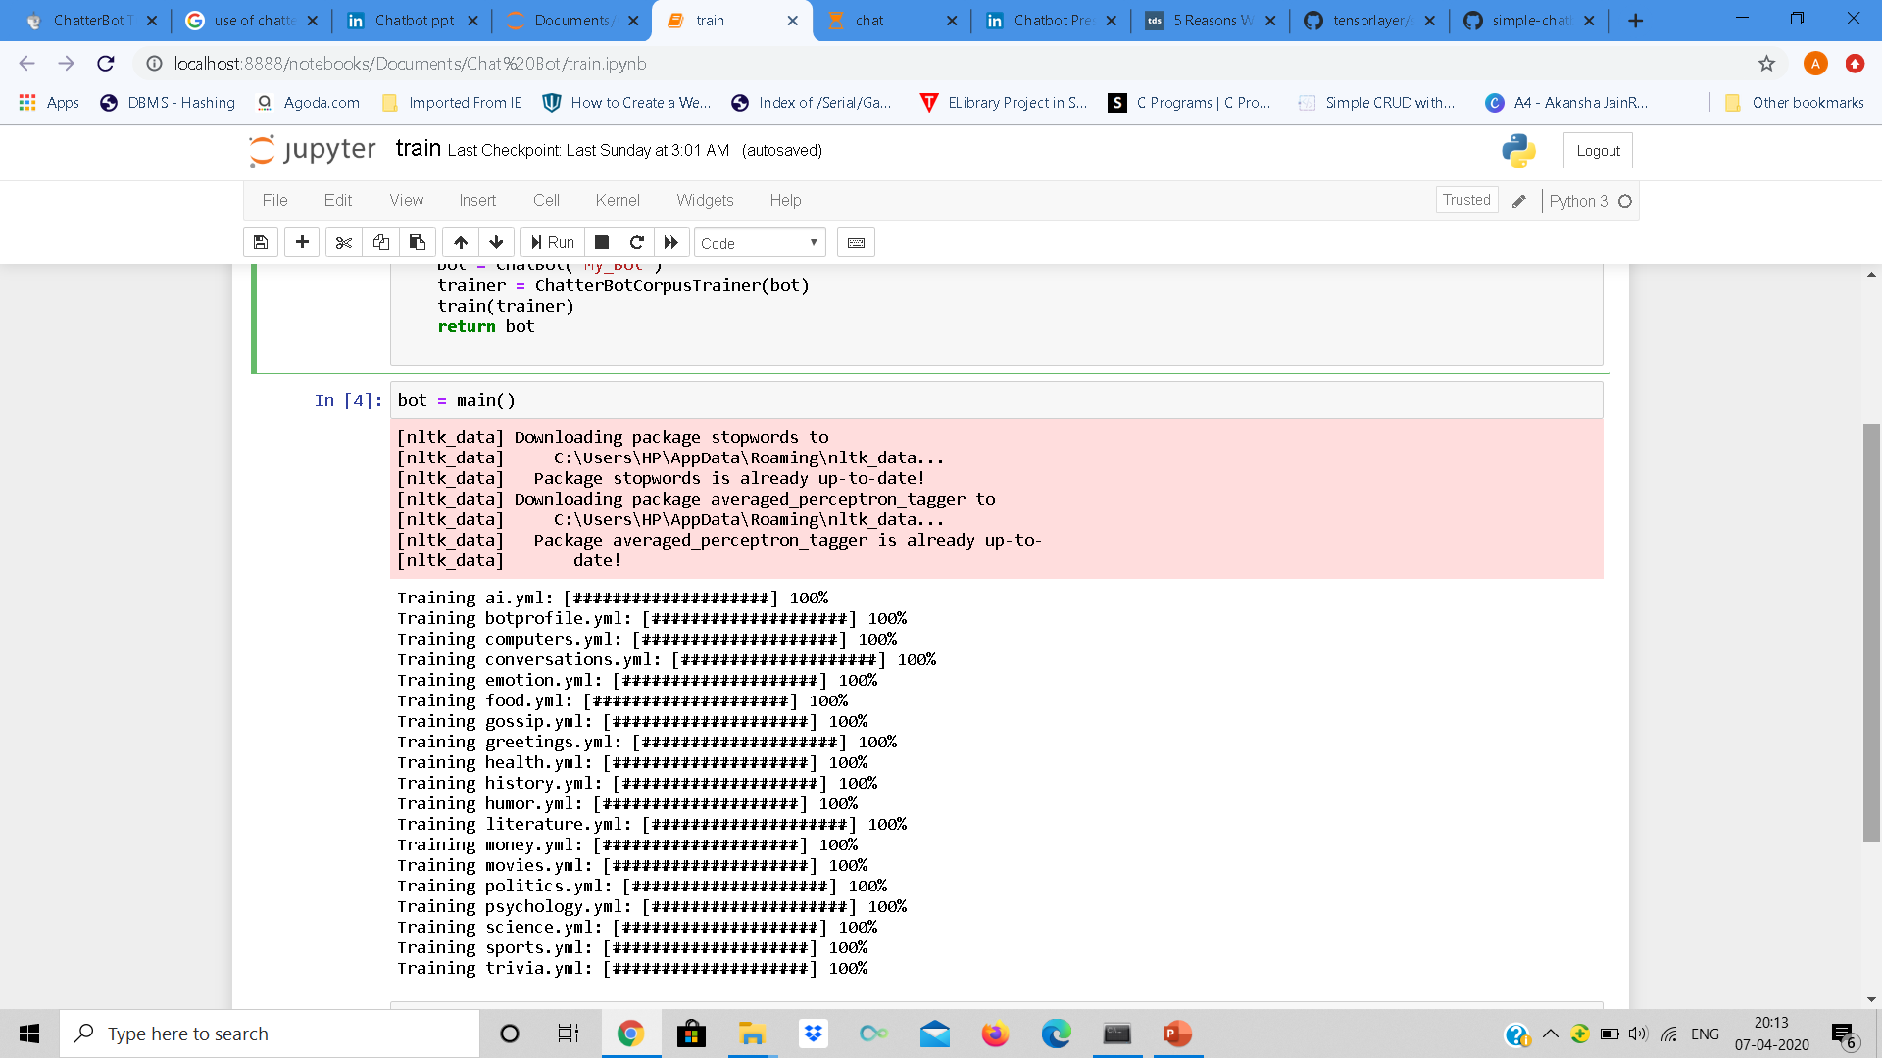
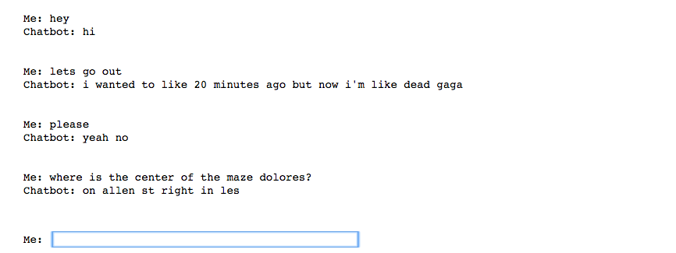
Intermediate Chat Bot Progress
Installation of ChatterBot:
Before interacting with the chatbot,
one needs to train the chatbot.
Dataset used is appropriate for a
simple English conversation.
Running the program:
Training python program
Output program

Slide 14
Aims for the Chatbot
To be able to modify the dataset, and include mathematical questions and answer to help engage the driver.
Integrate alarm system with the chatbot.
Integrate music system with the existing chatbot.

Slide 15
SYSTEM REQUIREMENTS
windows 7/8/10 or Ubuntu or OS X
Memory: 2 GB
Graphics: Intel Integrated Graphics Card, Open CV
Video Camera or Web cam
Audio Receiver
Speaker

Slide 16
THANK YOU

